Slide 1
Data Mining for Health: Investigating Weight Categories and Contributing Factors
IA650 – Fall 2024
Sagar Bangera
Nikhil Chhatraband

Slide 2
Introduction
Obesity is recognized as one of the leading public health concerns worldwide.
Over 1.9 billion adults worldwide were overweight in 2022, with 650 million classified as obese (World Health Organization).
Obesity is linked to over 200 health complications, including diabetes and heart disease.
Identifying obesity trends isn’t just about numbers—it's about empowering preventive healthcare.
This data is available at https://www.kaggle.com/competitions/playground-series-s4e2/data?select=train.csv

Slide 3
Objective
To analyze lifestyle and demographic factors influencing obesity levels.
Examine the relationship between dietary habits, physical activity, and obesity.
Use smart models to figure out if it's the calories or the Netflix marathons that matter more.
Turn data into insights that can help us all make healthier (and happier!) choices.

Slide 4
Data source & Variables
Variable | Description | Unit
ID | Unique identifier | None
Gender | Gender of the individual | Male/Female
Age | Age of the individual | Years
Height | Height of the individual | Centimetres
Weight | Weight of the individual | Kilograms
family_history_with_overweight | Family history of being overweight | Yes/No
FAVC | Frequent consumption of high-calorie food | Yes/No
FCVC | Frequency of vegetable consumption | Scale (1–3)
NCP | Number of main meals consumed | Scale (1–4)
CAEC | Consumption of food between meals | Categories
SMOKE | Smoking habits | Yes/No
CH2O | Daily water intake | Scale (1–3)
SCC | Skipping Caloric Consumption (skipping meals) | Yes/No
FAF | Physical activity frequency | Scale (0–4)
TUE | Time spent using technology | Scale (0–2)
CALC | Alcohol consumption | Categories
MTRANS | Mode of transportation used | Categories

Slide 5
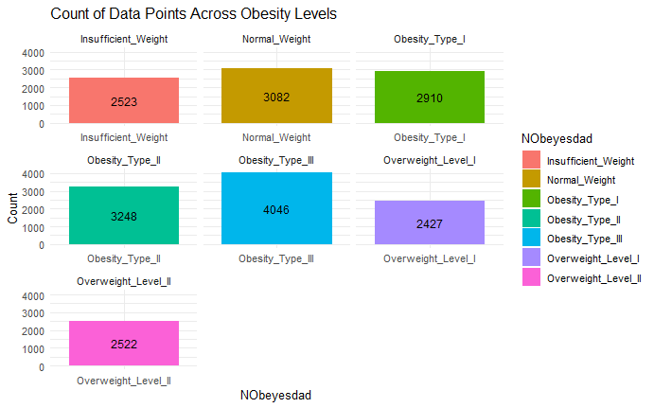
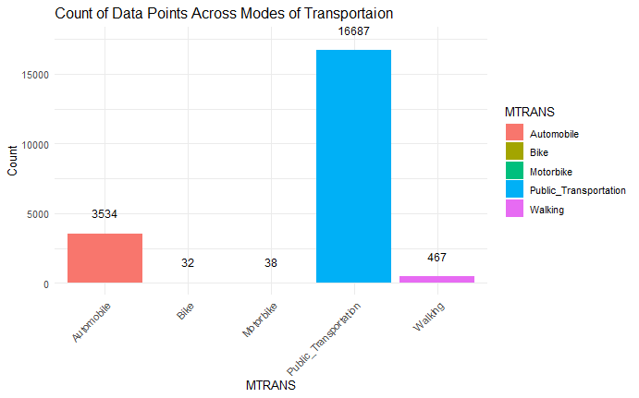
Data Visualizations

Slide 6
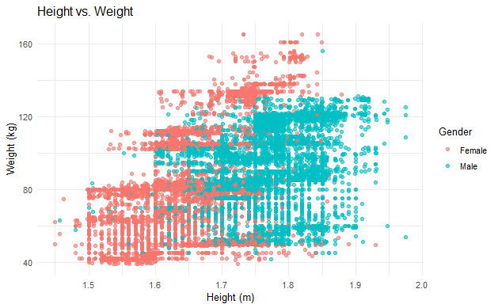
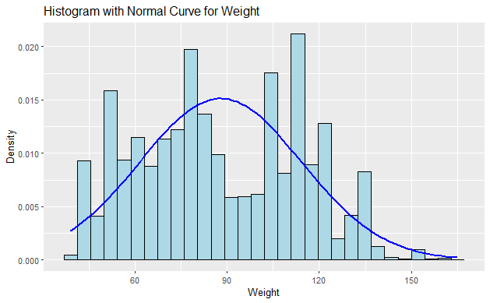
Data Visualizations
Even with longer heights the number of men having weight more than 120 is lesser compare to female.
The weights are not normally distributed in the dataset.

Slide 7
Kolmogorov-Smirnov test
Used to test if data is normally distributed, which is a common assumption for many statistical tests.
data: data$Weight
D = 0.091, p-value = 2.2e-16
D is the maximum deviation between the cumulative distribution functions (CDF) of your data and the specified normal distribution.
The data can be termed normal if D value is 0 and p-value is small.

Slide 8
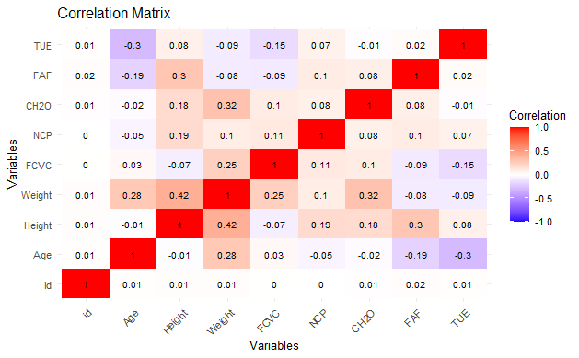
Correlation Plot
Height and weight have a significant positive correlation.
Age appears to have a mixed relationship with various factors..
Most of the other correlations are weak.

Slide 9
Variance Inflation Factor (VIF)
Age | Height | Weight | FCVC | NCP | CH2O | FAF | TUE
1.25 | 1.50 | 1.67 | 1.156 | 1.07 | 1.14 | 1.20 | 1.14
All VIF values are below 5, with the highest being around 1.67 (for Weight).
This suggests that each predictor variable is only weakly correlated with the others, meaning that multicollinearity is not a concern in this model.

Slide 10
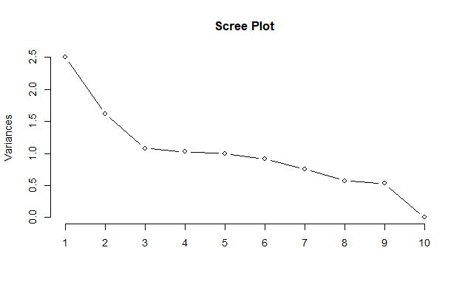
Principal Component Analysis (PCA)
 | PC1 | PC2 | PC3 | PC4 | PC5 | PC6 | PC7 | PC8 | PC9 | PC10
Standard Deviation | 1.58 | 1.27 | 1.04 | 1.01 | 0.99 | 0.96 | 0.87 | 0.77 | 0.73 | 0.06
Cumulative Proportion | 0.25 | 0.41 | 0.52 | 0.62 | 0.72 | 0.81 | 0.89 | 0.95 | 0.99 | 1.00
Capture the maximum variance in the data.
PC1 has the highest standard deviation & explains 25.01% of the variance.
Elbow appears to be around PC3 or PC4

Slide 11
Categorical Analysis
Chi-squared test
Considering Obesity levels as our target variable.
All p-values are effectively zero (very small), meaning all tested variables are significantly associated with Obesity levels.
 | Gender | family_history | FAVC | CAEC | SMOKE | CALC | MTRANS | SCC
Chi-squared | 7953.8 | 6423.3 | 1553.6 | 6897.3 | 216.3 | 4013.1 | 2349.1 | 1024.8
p-value | < 0.0001 | < 0.0001 | < 0.0001 | < 0.0001 | < 0.0001 | < 0.0001 | < 0.0001 | < 0.0001

Slide 12
Categorical Analysis
Cramér’s V Test
Cramér's V is a measure derived from the Chi-squared statistic, providing a value between 0 and 1 where values closer to 0 suggest little association and values closer to 1 indicate strong association.
So here we will not consider FAVC, SMOKE, MTRANS & SCC for our final model.
 | Gender | family_history | FAVC | CAEC | SMOKE | CALC | MTRANS | SCC
Value | 0.62 | 0.56 | 0.27 | 0.33 | 0.10 | 0.31 | 0.17 | 0.22

Slide 13
Statistical Analysis
ANOVA Test
Considering Obesity levels as our target variable.
Weight, Age and Height show high F-values, indicating significant differences across obesity levels.
Extremely low p-value suggests that the differences in the means of each variable across obesity levels are statistically significant.
 | Age | Height | Weight | FCVC | NCP | CH2O | FAF | TUE
F value | 962.9 | 759.6 | 22868 | 1552 | 300.3 | 385.8 | 282.7 | 147.2
p-value | < 0.0001 | < 0.0001 | < 0.0001 | < 0.0001 | < 0.0001 | < 0.0001 | < 0.0001 | < 0.0001

Slide 14
Statistical Analysis
 | Estimate | Std. Error | t value | p value
Intercept | 5.386 | 0.268 | 20.064 | < 0.0001
Age | 0.058 | 0.002 | 23.988 | < 0.0001
Height | -2.728 | 0.160 | -17.052 | < 0.0001
Weight | 0.032 | 0.001 | 56.741 | < 0.0001
FCVC | -0.271 | 0.023 | -11.822 | < 0.0001
NCP | -0.273 | 0.017 | -16.350 | < 0.0001
CH2O | 0.275 | 0.020 | 13.774 | < 0.0001
FAF | 0.011 | 0.015 | 0.702 | 0.483
TUE | 0.049 | 0.020 | 2.477 | 0.013
Multiple Linear Regression
Variables like Age, Height, Weight, FCVC, NCP, CH2O have strong relationship with the dependent variable.
We will ignore FAF & TUE for our model.
Residual standard error: 1.641 on 20749 degrees of freedom
Multiple R-squared: 0.2493, Adjusted R-squared: 0.2491
F-statistic: 861.5 on 8 and 20749 DF, p-value: < 2.2e-16

Slide 15
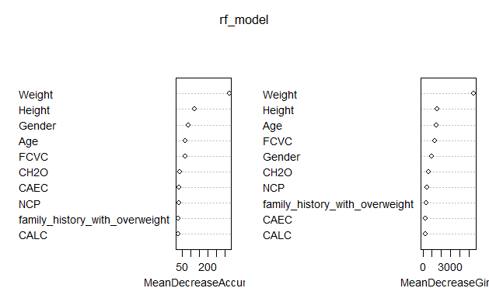
Random Forrest
Using the Random Forrest model for the chosen variables we achieve a very high accuracy.
"Accuracy: 0.896“
Weight, Height, and Age as the most significant predictors for classifying obesity categories
Lifestyle factors like diet and hydration also play essential roles but to a lesser extent.

Slide 16
Decision Tree
Accuracy | 95% CI | No Information Rate | P-value [Acc >NIR]
0.824 | (0.813, 0.834) | 0.195 | < 0.0001
Using the Decision Tree model for the chosen variables here too we achieve a very high accuracy.
"Accuracy: 0.824 “
Since the p-value is less than 0.05 we reject the null hypothesis indicating that the model's accuracy is significantly better than the no information rate.

Slide 17
Limitations
Since the dataset is not normally distributed.
Results of the ANOVA & Chi-Square test may not be valid.
Reduced model performance in Random Forrest.
Reduced interpretability in Decision Tree.
Don’t know much about relationships of numerical vs categorical variables.
Random Forest can sometimes overemphasize categorical variables with many levels.
Decision trees are easy to interpret but prone to overfitting. The model we made excels particularly in identifying individuals with Obesity Type III, showing a sensitivity near perfect at 99.7% but weaker performance in distinguishing Overweight Level II, where sensitivity is only 58.73%.

Slide 18
Future Scope
Apply transformations (e.g., log, square root, etc.) to normalize distributions.
Collect longitudinal data to study how obesity evolves over time and track lifestyle changes.
Integrate geolocation data to study the impact of environmental factors like access to parks, gyms, or fast-food outlets.
Use techniques like SHAP values or gradient boosting methods like XGBoost or LightGBM for better accuracy.
Use techniques like cross-validation, hyperparameter tuning to mitigate overfitting.

Slide 19
Acknowledgments
We are grateful to Dr. Sumona Mondal for your guidance throughout this semester, it’s obvious that this project wouldn’t have been possible without you.
To Naveen Ramachandra Reddy, thanks for all the tips and suggestions
Also to our beloved classmates for all the discussions we had regarding these topics.

Slide 20
References
https://www.itl.nist.gov/div898/handbook/eda/section3/eda35g.htm
https://www.jstor.org/stable/2280095?
https://www.spss-tutorials.com/cramers-v-what-and-why/
https://scikit-learn.org/stable/modules/generated/sklearn.ensemble.RandomForestClassifier.html

Slide 21
Thank You !

